Slide 1
Big Mountain Ski Resort Pricing Strategy
By: Lupe Covarrubias

Slide 2
Problem Identification
How can the Big Mountain Ski Resort capitalize on their facilities or decrease operational costs without undermining the ticket price, and keeping the price at or below the average, before the next skiing season begins?
Installation of chair lift inc. operating costs by $1.54M
Investigating solutions through data to determine the best value for a ticket price
Facilities that can be capitalized on and keep ticket price inc. at a minimum
Resorts that have the most similarity to Big Mountain and compare ticket prices
Evaluate features that have the most influence on ticket prices
Constraints: missing data on lodge, services, and conveniences
Key data sources: SQL database, S3 bucket

Slide 3
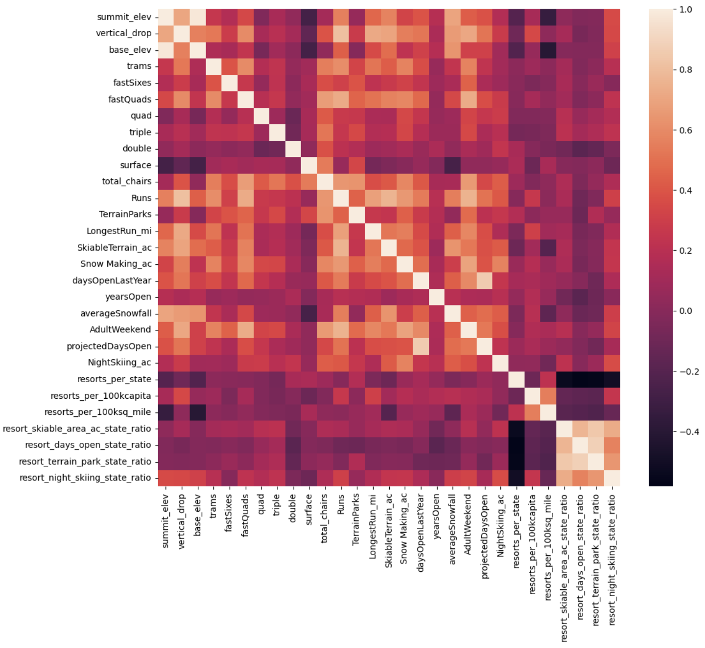
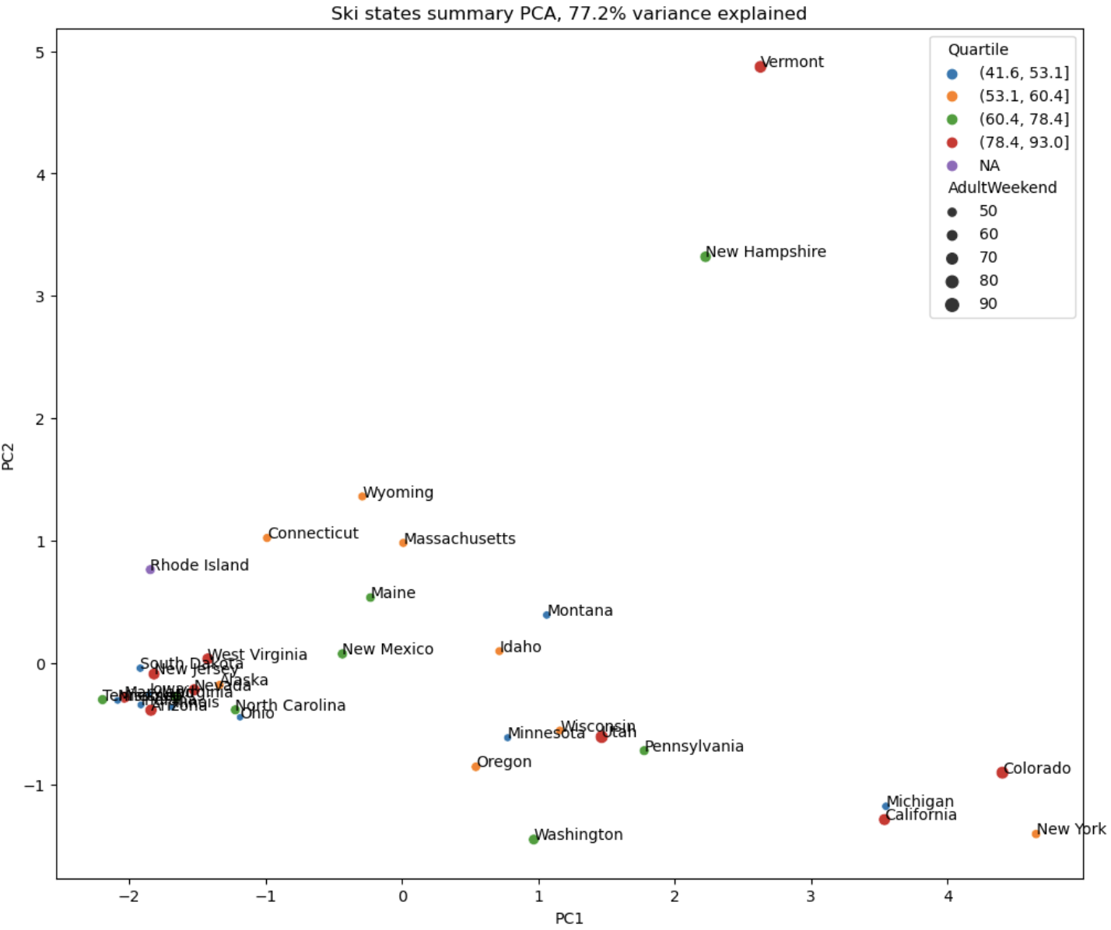
Recommendation and Key Findings
PCA conveys similar resorts
Montana was unique and not quite similar
Features used as targets: number of resorts, runs, total chairs, vertical drop, longest runs, snow making ac, skiable terrain, and days open last year
Features are highly correlated with ticket price which was identified through heatmap and scatter plot
There is room for improvement!

Slide 4
Modeling Results and Analysis
Mean ticket price = $64
Used linear regression and random forest regression
Cross validation model portrayed random forest model gave the best results
BM currently charges $81 per ticket, modeled price is $96 which is much higher than the current
No set price that the resort has to set ticket prices to
Additional cost for chair lift is $1.54M
Possible scenarios for cutting costs or increasing revenue
Permanently closing down up to 10 of the least used runs
Increase vertical drop by 150 ft
Increase vertical drop and add 2 acres of snow making coverage
Increase longest run by 0.2 miles

Slide 5
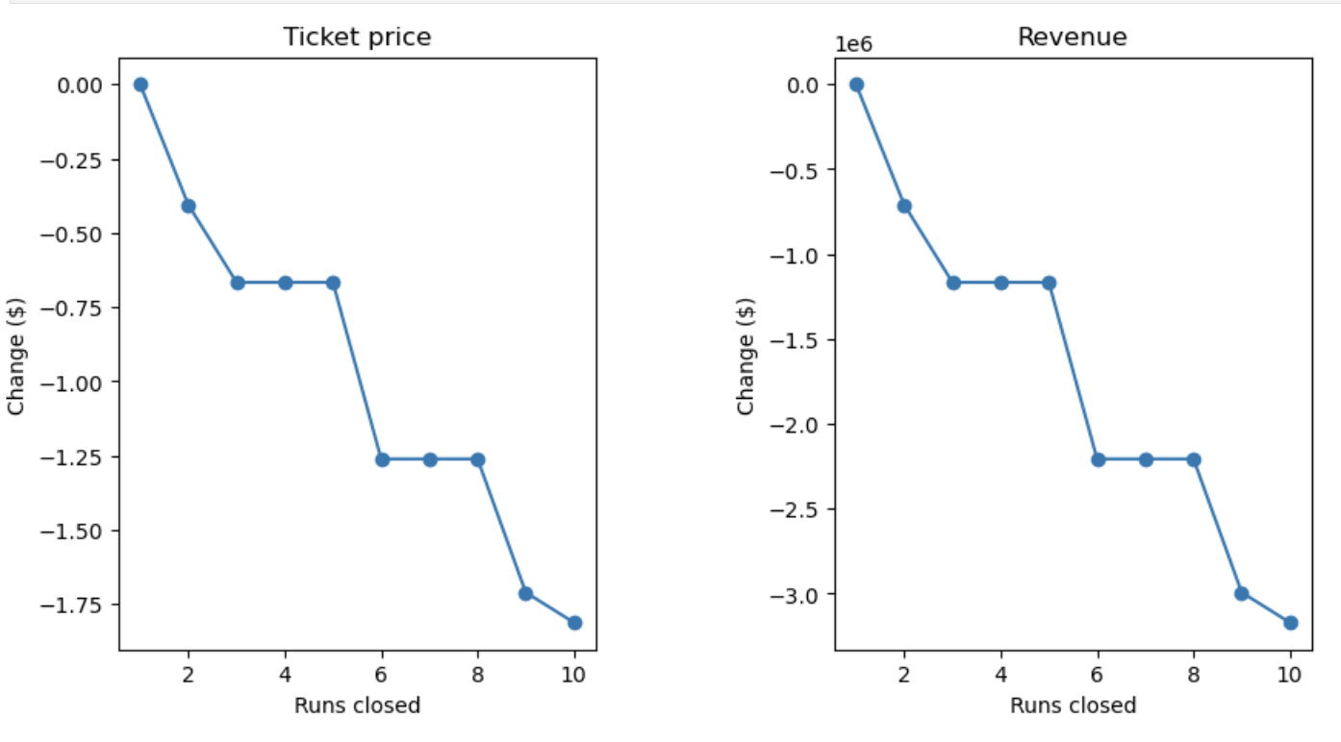
Modeling Results and Analysis
Scenarios
Lose money in ticket price with the more runs that are closed as shown in the figure
Best scenario was increasing vertical drop, supported ticket price increase by $2 allowed for an annual estimated profit of $3.47M
Addition of snow making on top of vertical drop inc. made no difference
Increasing longest run by 0.2 miles makes no difference in profit or ticket price

Slide 6
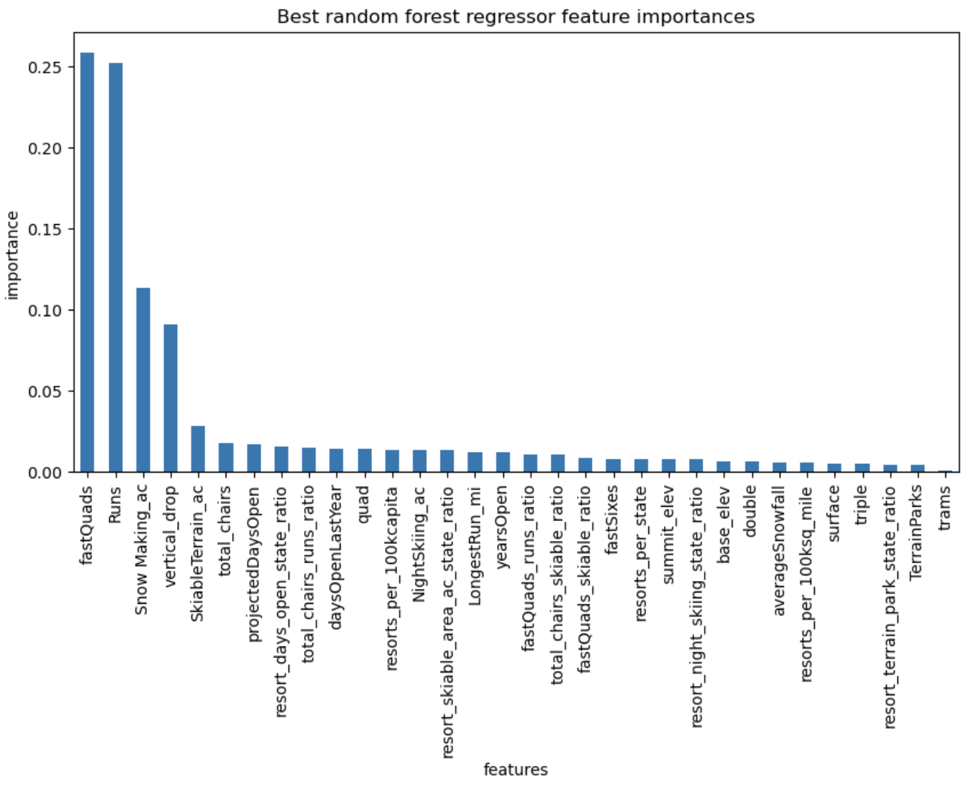
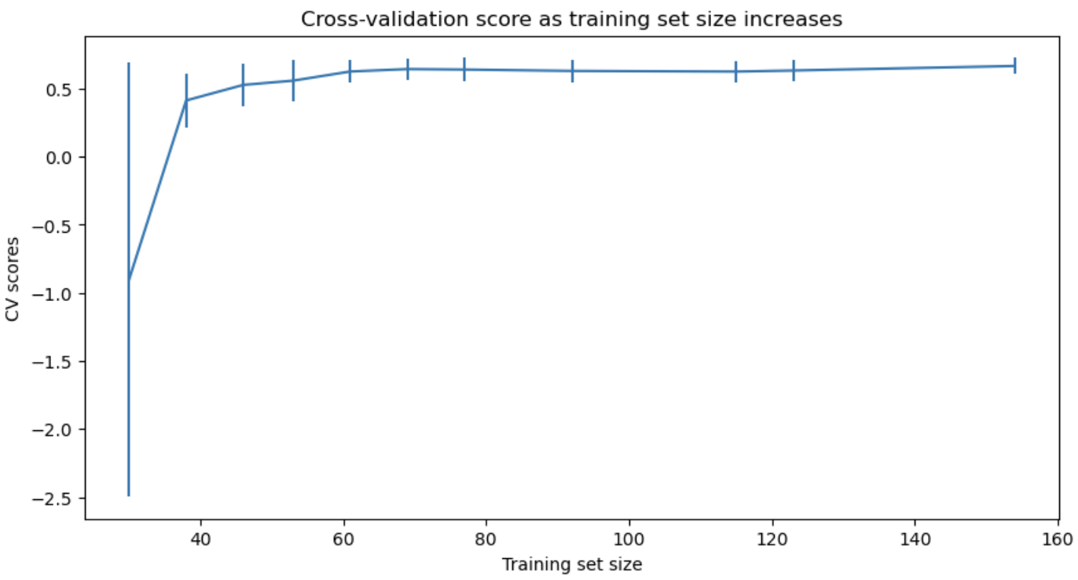
Modeling Results and Analysis

Slide 7
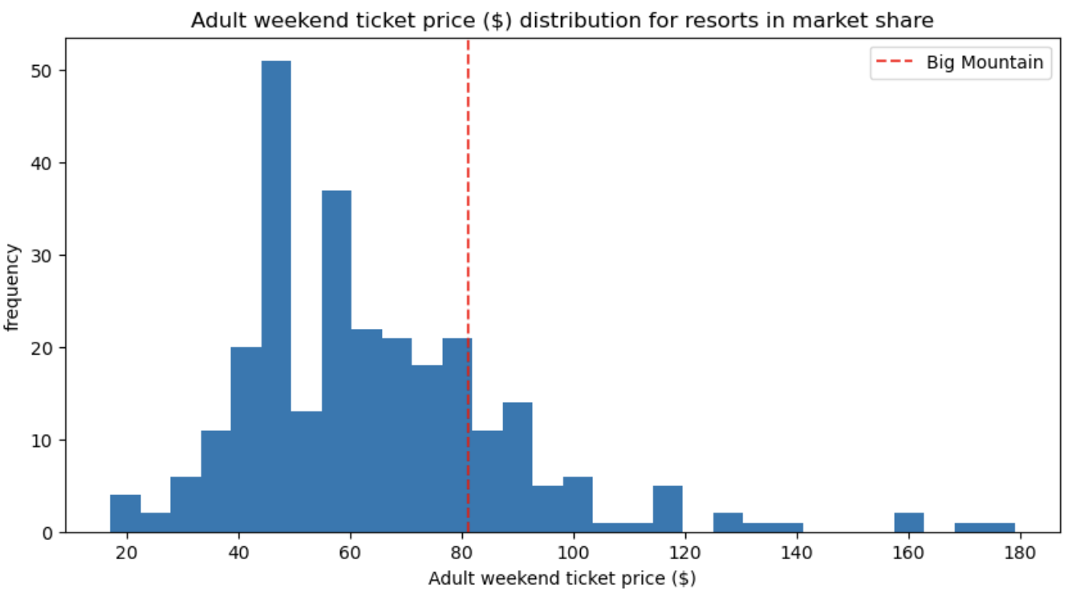
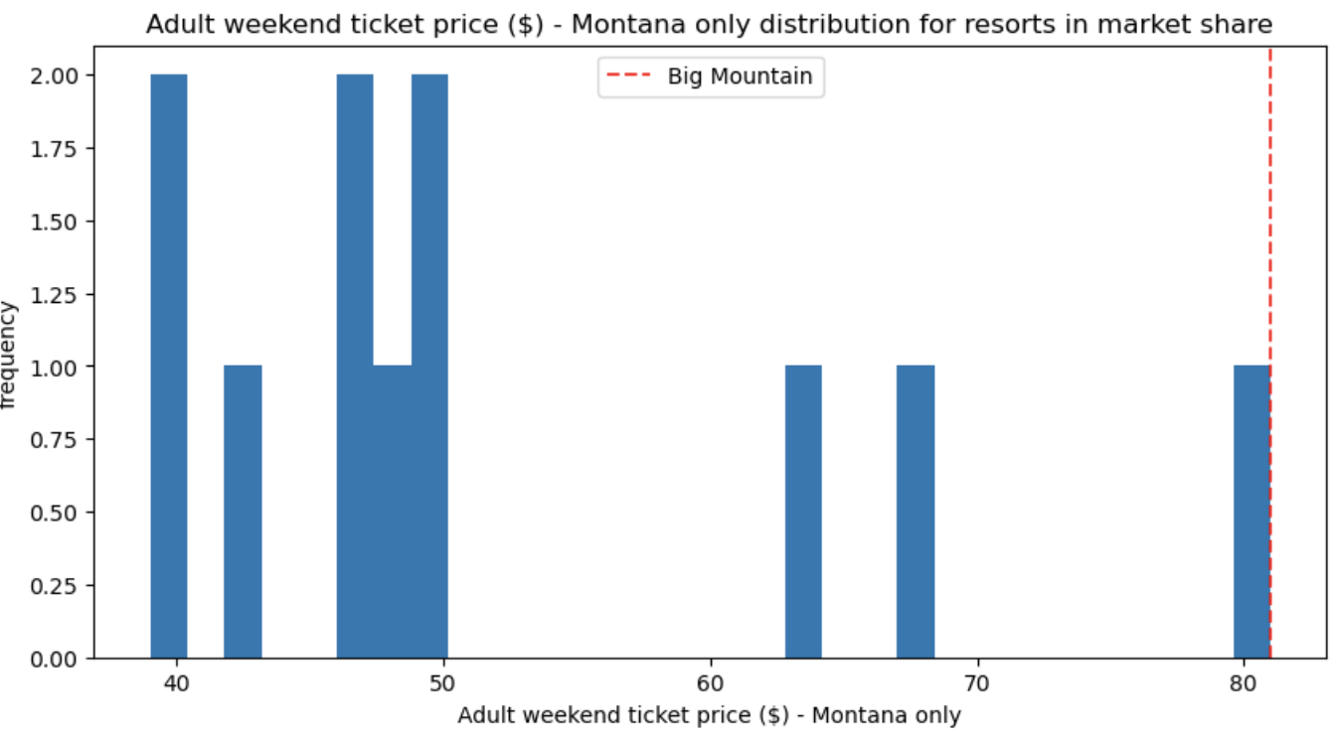
Modeling Results and Analysis

Slide 8
Summary and Conclusion
BM modeled price is $96 per ticket with MAE of about $10
Best scenario: increase vertical drop by 150 ft
Supports ticket price inc. by $2
Potential revenue: $3.47M
Idea: increase ticket price incrementally every season until desired ticket price is reached
Missing data that may be helpful in gaining more accurate insights:
Lodge operations
Ski rental equipment
More data needed to understand why there is such a large gap in actual versus modeled ticket price
Data is still useful because it conveys there is leniency on increasing ticket price

